Slide 1
Storing Data on Android
Basis Data Klien Server

Slide 2
Storage Options
Shared Preferences
Store private primitive data in key-value pairs.
Internal Storage
Store private data on the device memory.
External Storage
Store public data on the shared external storage.
SQLite Databases
Store structured data in a private database.
Network Connection
Store data on the web with your own network server.

Slide 3
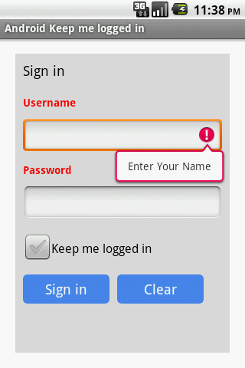
Shared Preferences

Slide 4
Shared Preferences
getSharedPreferences() :
Use this if you need multiple preferences files identified by name, which you specify with the first parameter.
getPreferences()
Using this method you can create Single SharedPreferences.

Slide 5
Shared Preferences
Save Data
// Create object of SharedPreferences. SharedPreferences sharedPref= getSharedPreferences("mypref", 0);
//now get Editor SharedPreferences.Editor editor= sharedPref.edit();
//put your value editor.putString("name", strName);
editor.putString("pwd", strPass);
//commits your edits editor.commit();

Slide 6
Shared Preferences
Retrieve Data
SharedPreferences sharedPref= getSharedPreferences("mypref", 0);
String name = sharedPref.getString("name", "");
String password = sharedPref.getString("pwd", "");
Note : Its store data until you clear data from app or uninstall app.

Slide 7
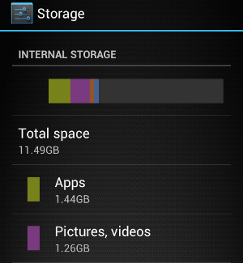
Internal Storage
Internal storage are private to your application and other applications cannot access them (nor can the user).
When the user uninstalls your application, these files are removed.

Slide 8
Internal Storage
To create and write a private file to the internal storage:
String FILENAME = "hello_file"; String text = "hello world!"; FileOutputStream fos = openFileOutput(FILENAME, Context.MODE_PRIVATE);
fos.write(text.getBytes());
fos.close();
MODE_PRIVATE → will create the file (or replace a file of the same name) and make it private to your application

Slide 9
Internal Storage
To read a file from internal storage:
Call openFileInput() and pass it the name of the file to read. This returns a FileInputStream.
Read bytes from the file with read().
Then close the stream with close().

Slide 10
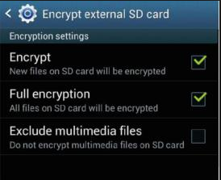
External Storage
External storage such as SD card can also store application data, there's no security enforced upon files you save to the external storage.
All applications can read and write files placed on the external storage and the user can remove them.

Slide 11
External Storage
// add uses permission
<uses-permission android:name="android.permission.WRITE_EXTERNAL_STORAGE" />
// check external storage is available and not read only?
if (!isExternalStorageAvailable() || isExternalStorageReadOnly()) {
saveToExternalStorage.setEnabled(false);
}

Slide 12
SQLite
SQLite is used to store more structured data locally in a mobile where the android app is running.

Slide 13
Network Connection
You can use the network (when it's available) to store and retrieve data on your own web-based services.

Slide 14


